Slide 1
NBA 2013 Predictions using Logistic Regression
Machine learning final project
Shitosh Parajuli

Slide 2
Project requirement:
Implement logistic regression in a dataset
Use training data to learn about the outcomes and get predictions
Use the prediction on test data to see the prediction precision

Slide 3
Project Specifications
Prediction: If a team qualified for the NBA playoffs or not
Training data: Scores of all NBA teams from 1980 – 2012 including Wins, Points Scored, Point Conceded, 2 pointers scored, 2 pointers attempted, 3 pointers scored, 3 pointers attempted and Free throws (835 data sets)
Test data: Scores of NBA teams from 2013 considering same criteria as training data to see if the prediction would be valid (28 data sets)

Slide 4
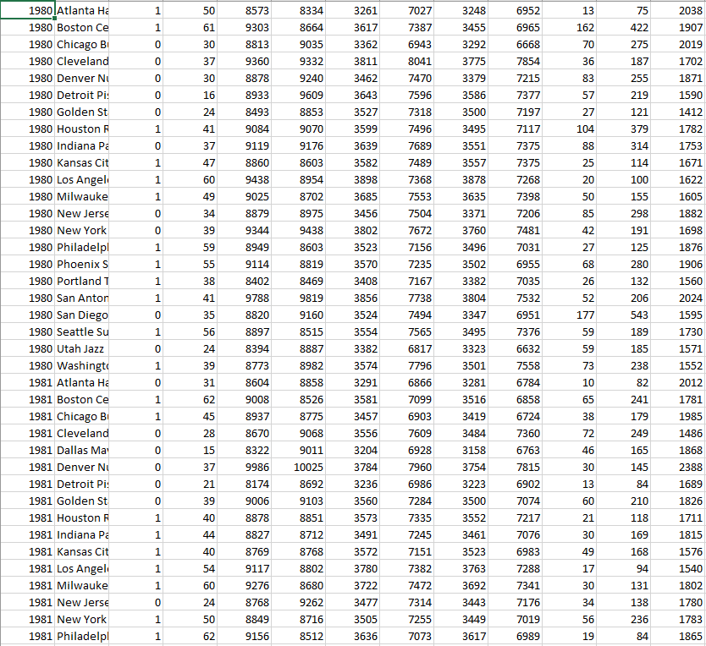
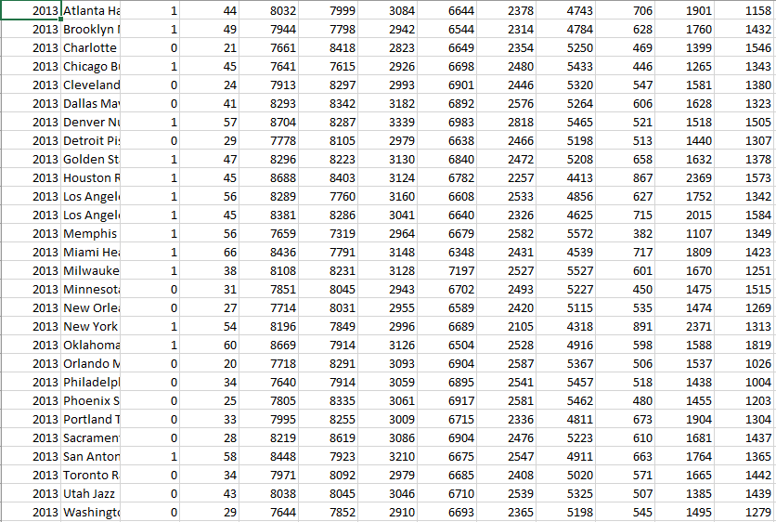
Sample data:

Slide 5
Libraries used
Numpy
Scipy
Scikit – learn
LogisticRegression from sklearn.linear_model

Slide 6
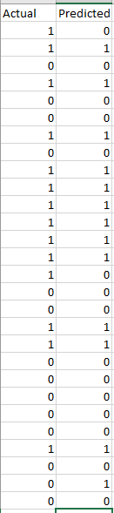
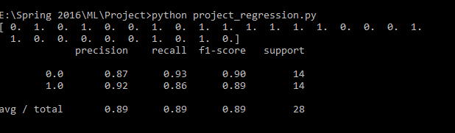
Results:
The actual vs predicted result of the test data, i.e., the 2013 playoff results:
Correct: 25 Incorrect: 3
Result was calculated with 89.2% accuracy.

